Slide 1
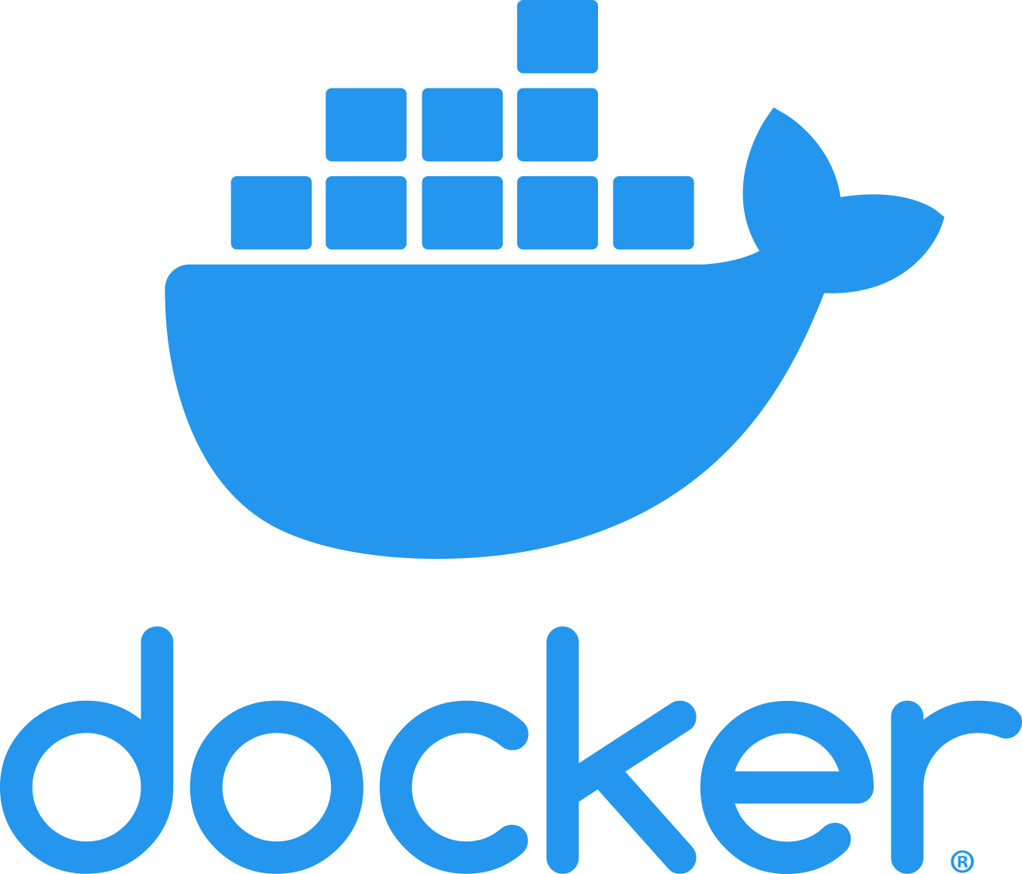
Notes:
Hello Everyone, My name is Anish Rana. Today I have came with new Topic called Docker.

Slide 2
Agenda
What resources are required to run an application.
Traditional way of hosting an applications.
Why we need virtualization?
Why we need Container?
Difference between VM and Container.
What is container.
What is Docker?
Notes:
Today, our agenda is, 1. What resources are required to run an application.
and last, we will talk about What is Docker?

Slide 3
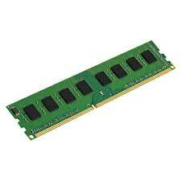
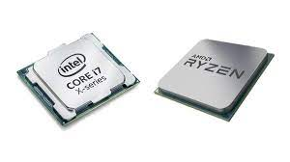
Application
RAM
CPU
Disk
Libraries
Binaries
Physical Server
Operating System
Notes:
To Run an application whether it is NGINX , NODE.JS any application, it requires RAM, CPU and DISK.
Application demand these resources from Operating System.
Whether this OS is installed on Physical Server or in Virtual machine.
This Operating System has libraries and binaries files.
Libraries are used by Application and Binaries files are used by CPU.

Slide 4
In 1990
Let’s assume, we are in 1990 and there is no Virtualization concept in the market. We need to deploy 3 application servers, i.e. Vmanage , Vbond and Vsmart servers.
Each application may share the Operating System (OS) libraries, Sometime, one application require lower libraries version and other application requires higher version.
Thus, we installed these applications on separate hardware.
Each server should have at least 4 GB RAM, 20 GB Hard disk and 2 CPU. Very minimal configuration we opt for this.

Slide 5
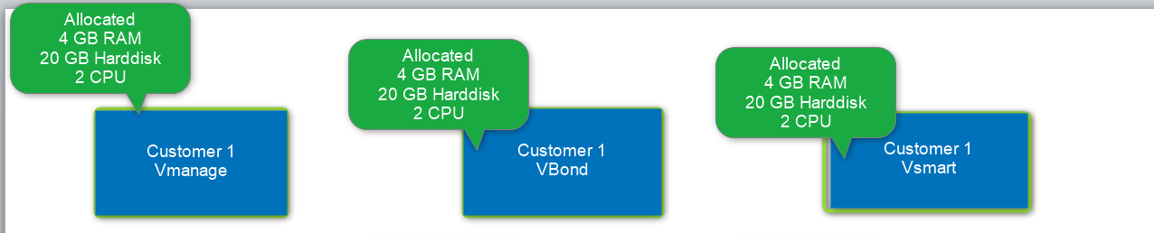
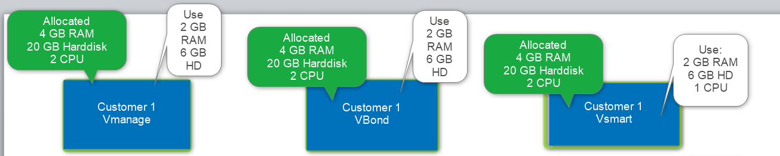
Each server should have at least 4 GB RAM, 20 GB Hard disk and 2 CPU. Very minimal configuration we opt for this.
However, they consume less resources.

Slide 6
 | Allocated | Used | Waste
Total RAM | 12 GB | 6 GB | 6 GB
Hard disk | 60 GB HD | 18 GB | 42 GB
CPU | 6 | 3 | 3
On the top of that below points also need to be considered.
3 Servers Hosting space
Physical cabling
Power adapter
Physical switch
Lot of manual work

Slide 7
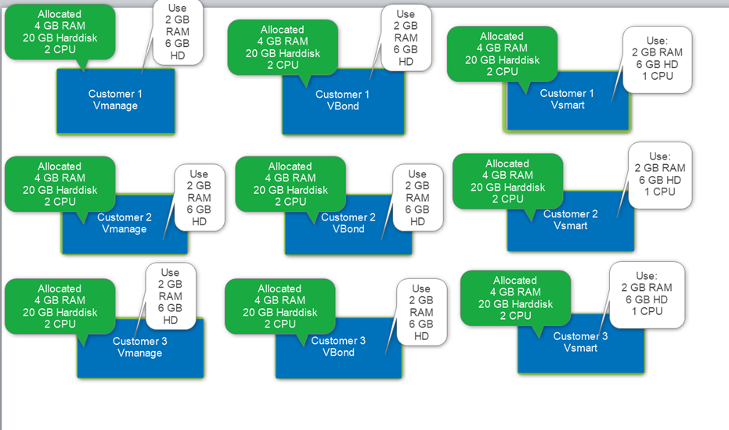
Now, imagine, we have 3 customers and therefore, we have to deploy 9 servers for them.

Slide 8
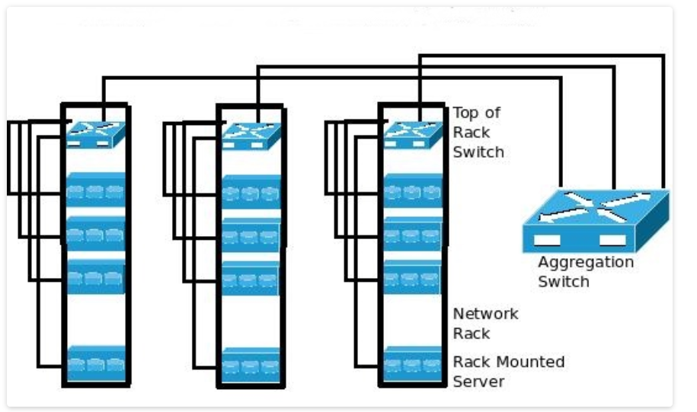

Slide 9
Now, if we need a replica of these servers then we need another 9 servers.
9 Servers Hosting space
Physical cabling
Power adapter
Physical switch
Lot of manual work
 | Allocated | Used | Waste
Total RAM | 36 GB | 18 GB | 18 GB
Hard disk | 180 GB HD | 54 GB | 126 GB
CPU | 18 | 9 | 9
Notes:
To optimize the resource utilization, Virtualization came in the market.

Slide 10
Virtualization
Resources Utilization
Physical server
Virtual Machine
Virtual Machine
Virtual Machine
Applications
Guest OS 3
Application Node JS
Application NGINX
Application Apache
Guest OS 2
Guest OS 1
Guest Operating system
Guest Operating system
Guest Operating system
Hypervisor
Hypervisor
Notes:
Frist, we mount the physical server in the DataCenter.
Then, we need to install the Hypervisor. Here, we may use Vmware provided Hypervisor like ESXi or Redhat KVM.
After that, we need to create Virtual machine called VM and in this VM, we will install the guest Operating System.
Due to the limitation of libraries files and some other conditions, we install one application on one server.
For that reason, we install three VMs. Running Applications are Node.JS, NGINX, and Apache web server.
Here, Intentionally, I have changed the application name because, we can install any application.
In the resource utilization bar, one can notice that 3 OS and Applications are consuming lot of resources.
We can’t stop Application server, but we can curb the OS. This can be done by using Container technology.

Slide 11
Application Server
Application Server
Python 3.9.6
Python 2.8
Redhat 7.0
Redhat 6.5
Notes:
We have discovered in the previous slide that to run an application need different resources, libraries and binaries files.
For example, for one application, we need latest Python version 3.9.6. So, we upgraded the Python version it in the lab server and this lab server has Redhat 7.0 OS installed. Developer did the test and verified that this application server is running as expected.
In the production, we observed that we are running Python 2.8 and OS is Redhad 6.5. Now, when we deploy this application server, we are getting error message.
However, in the case of Container, when we built the container image, we not only include the application but also the necessary libraries and binaries files.
It means, if the test are OK in Lab environment, then we will not observe any issue in the production.

Slide 12
containerization
Resources Utilization
Physical server
Container
Container
Container
Container
Container
Container
Application
Node JS
NGINX
Apache
App 1
App 2
App 3
Container
Container Engine(Docker)
Guest OS
Guest Operating system
Notes:
For Container, again, we mount the physical server in the DataCenter.
Right after we installed Operating System. On the top of OS, we install the container engine i.e., Docker.
Now, we can create multiple containers. I will cover in my coming slides what is container.
For now, you can imagine that these containers are light weight and has the capability to run multiple containers.
From the Resources utilization bar, we can notice that only one Operating System and multiple containers are consuming resources.

Slide 13
Comparison between Container and VM
Physical server
Physical server
Virtual Machine
Virtual Machine
Virtual Machine
Container
Container
Container
Container
Container
Container
Application Node JS
Application NGINX
Application Apache
Node JS
NGINX
Apache
App 1
App 2
App 3
Guest Operating system
Guest Operating system
Guest Operating system
Container Engine(Docker)
Hypervisor
Guest Operating system
Notes:
If we compare VM and container
In a single Physical server, we can run multiple containers and each container has dedicated application.
So, we can save not only resource utilization but also save the disk space which is consumed by different OS.
Second advantage is we can scale up or down the Containers easily within less time as compared with VM.

Slide 14
Containers in the VM
Physical server
Virtual Machine
Virtual Machine
Virtual Machine
Virtual Machine
Container
Container
App 1
App 2
Application Node JS
Application NGINX
Application Apache
Container Engine
Guest Operating system
Guest Operating system
Guest Operating system
Guest Operating system
Hypervisor
Notes:
It is not necessary to install the Container engine only on Physical server.
which means, we can install Container Engine on VM too.

Slide 15
Installation of Apache server (Application)
apt-get -y install apache2
sed -i '$a\ServerName 127.0.0.1' /etc/apache2/apache2.conf
mkdir /var/www/container1/
cd /var/www/container1/
cat > index.html <<EOF
This is my webserver1
EOF
cd /etc/apache2
service apache2 start
cd /etc/apache2/sites-available/
cp 000-default.conf container1.conf
sed -i 's=DocumentRoot /var/www/html=DocumentRoot /var/www/container1/=' container1.conf
sed -i '/container1/ a \\tServerName localhost' container1.conf
a2ensite container1.conf
a2dissite 000-default.conf
service apache2 reload
Notes:
Let's explore commands that we need to run to create one application server.
For an example, to install Apache web server, first , need to execute the apt-get to install the Apache package.

Slide 16
What is Container
Application
RAM
CPU
Disk
Libraries
Binaries
Physical Server
Operating System
Notes:
In the case of Container, when we built the container image, we not only include the application but also the necessary libraries and binaries files.
It means, if the test are OK in Lab environment, then we will not observe any issue in the production.

Slide 17

Application
(Apache Web server)
LIB and BIN
Container
container is a standard unit of software that packages up code and all its dependencies, so the application runs quickly and reliably from one computing environment to another.
Notes:
Once we have configured the Apache web server in the lab, then we compile the image. In this image we include the running web server configuration file, supporting libraries and binaries files.
From this image, we will create container in the cloud, VM or physical server.

Slide 18
What is docker
Notes:
Docker is a set of platform as a service (PaaS) products that use OS-level virtualization to deliver software in packages called containers

Slide 19
Docker is an open platform for developing, shipping, and running applications. Docker enables you to separate your applications from your infrastructure so you can deliver software quickly.
With Docker, you can manage your infrastructure in the same ways you manage your applications. By taking advantage of Docker’s methodologies for shipping, testing, and deploying code quickly.
You can significantly reduce the delay between writing code and running it in production.
https://docs.docker.com/get-started/overview/
Notes:
Although there are many tools available such as Podman, LXD, Containerd, Buildah, RunC. , but Docker is more famous among them.

Slide 20
Take away
What resources are required to run an application.
Traditional way of hosting an applications.
Why we need virtualization?
Why we need Container?
Difference between VM and Container.
What is container.
What is Docker?
Notes:
From the today session, we learnt
what different resource required
Traditional way of hosting application on Physical server.
Owing to resource wastage, we need Virtualization
For the optimum utilization of resources, we are moving to containerization.
difference between VM and container.
Exactly what is Container
Finally, We understand Docker is used to mange the containers.

Slide 21
Next topic
How to install Docker on
AWS
Virtual Machine
- Start creating and modifying Container.
Notes:
How to install the Docker package on AWS or VM on my laptop?
Start creating and modifying containers.
I already uploaded this PPT on my Github account. Thus, you may download this PPT and the link you may find in the description of this video.

